Slide 1

Transferable skills
Creative examples

Slide 2
What are we looking for?
Leadership Dependability
Teamwork Organization
Communication Active listening
Interpersonal skills Critical thinking

Slide 3

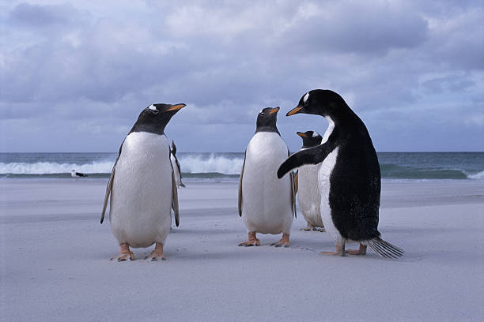
LEADERSHIP

Slide 4


DEPENDABILITY

Slide 5
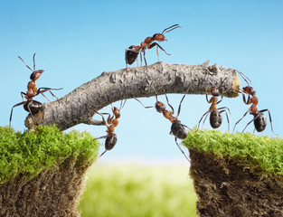

TEAM WORK

Slide 6
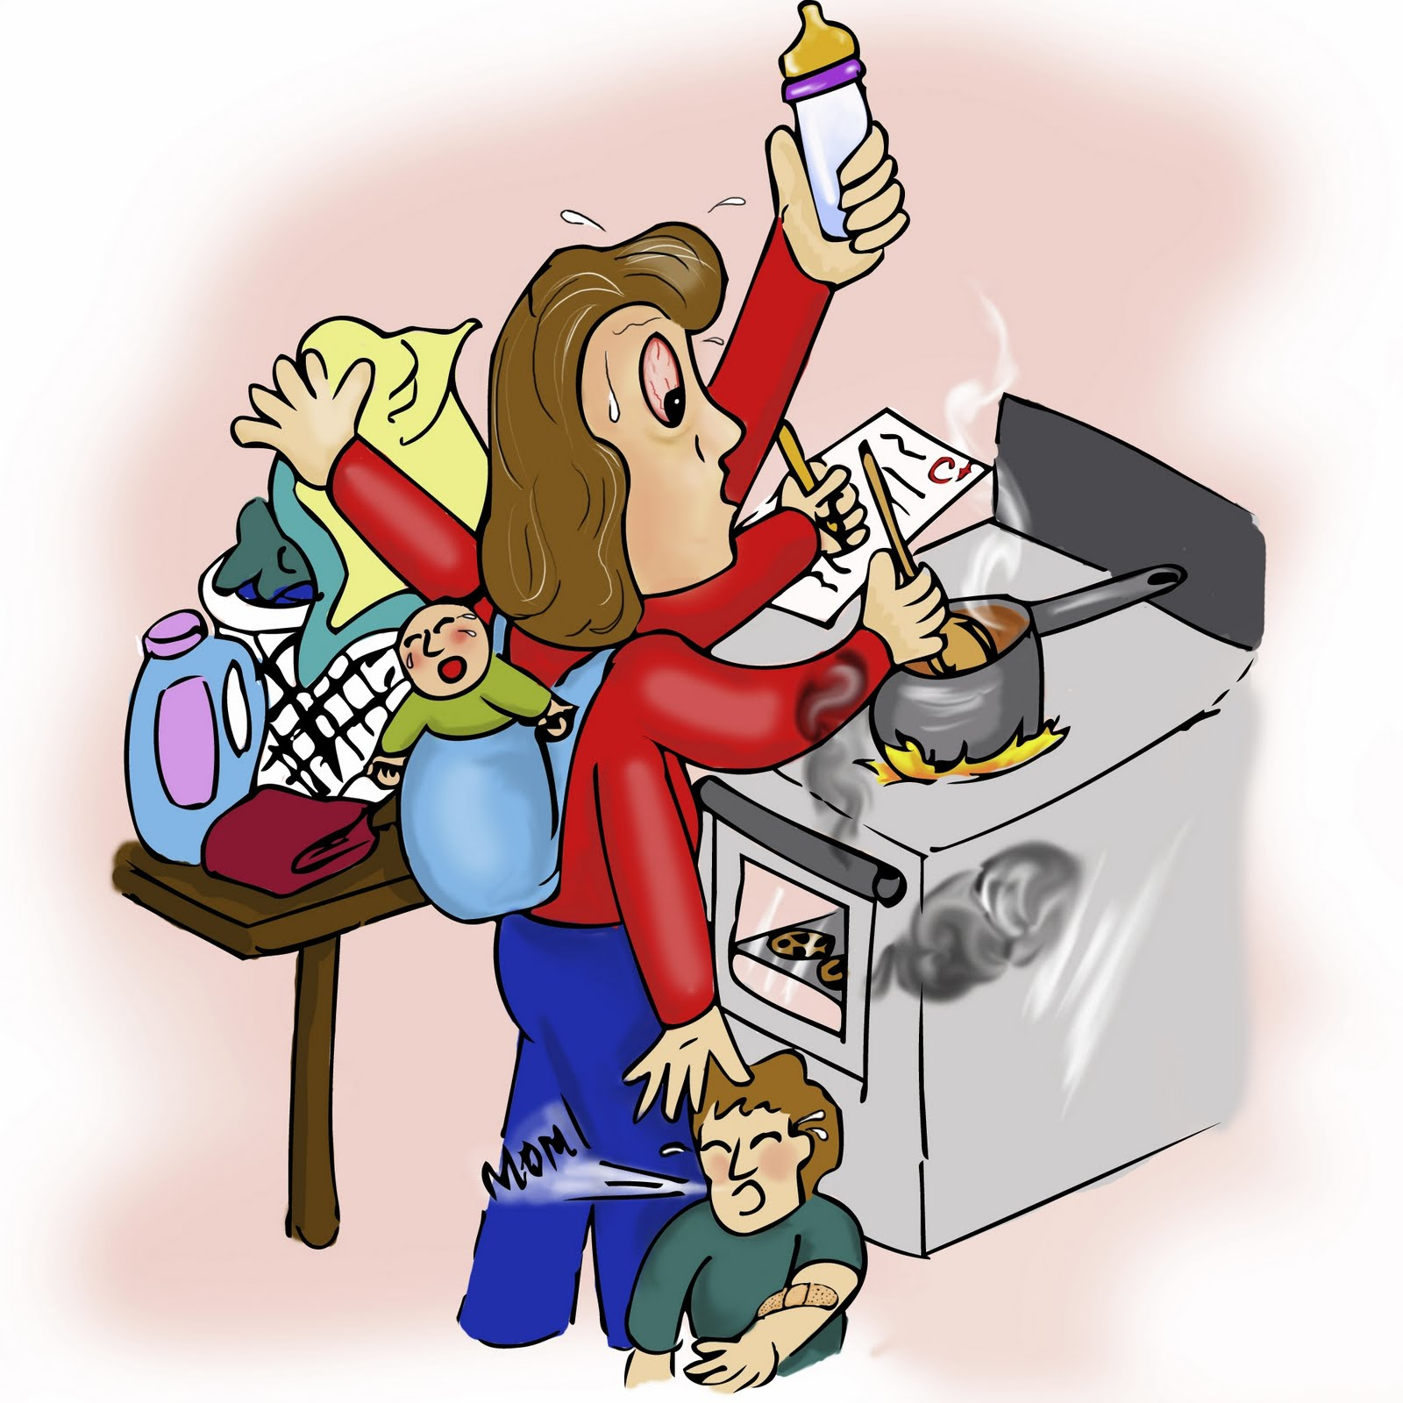

ORGANIZATION

Slide 7


COMUNICATION

Slide 8
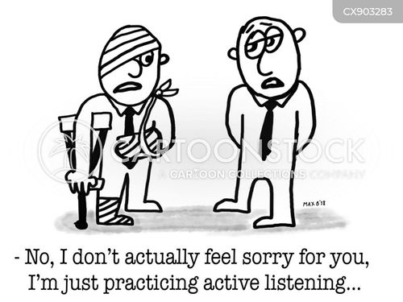
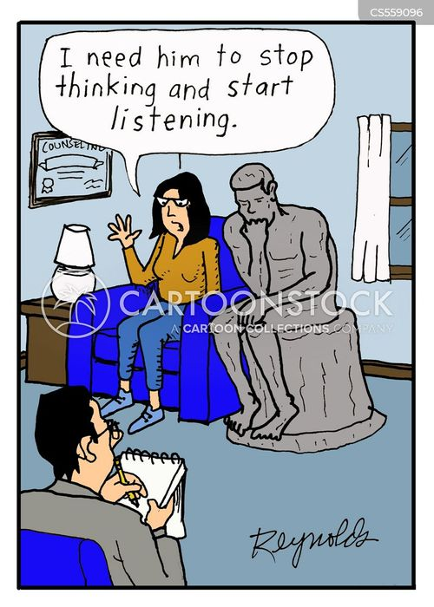
ACTIVE LISTENING

Slide 9


INTERPERSONAL SKILLS

Slide 10
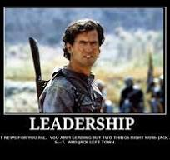
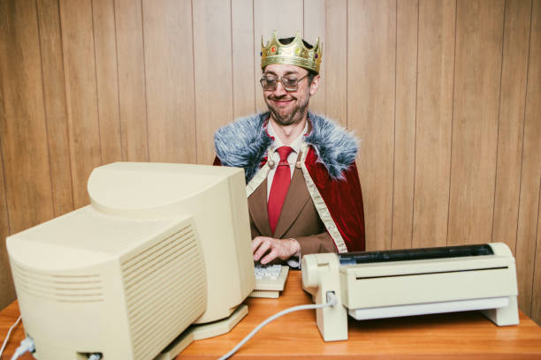
CRITICAL THINKING

Slide 11

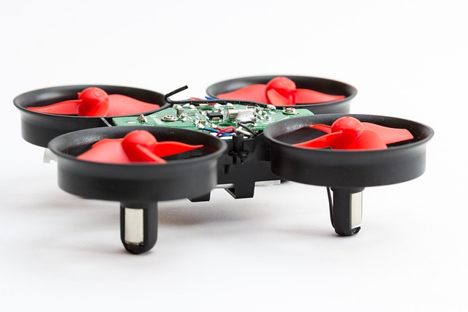
TECH

Slide 12

Thank you for giving us, 45 plus group, the opportunity to get together and learn what is new in computer skills.
Before a month ago we had no idea this existed!
Thank You

Slide 13




END

