Slide 1

MCG CAREERS
GROUP PROJECT

Slide 2

TOPICS
Transferable Skills
Resumes & Cover Letters
Interview skills
Power of Positivity and Building Your Confidence
Technology

Slide 3

Transferable Skills

Slide 4




Transferable Skills
Show that you CAN even though you
may not be a perfect match for the job.
Definition: Universal skills, habits, and abilities applicable to any industry or role.
The Purpose: Shows you CAN do the job even without a perfect background match.
The Strategy: Reframe your past experience to show value to a new employer.
Who Needs Them? Essential for new graduates, career changers, and workforce returnees.

Slide 5
Examples of Transferable/Portable Skills
Critical Thinker - An employee who routinely questions the popular opinion in meetings to ensure that correct decisions are made - A mechanic who must evaluate the correct tools that are needed for a job
Problem Solver - A receptionist who quickly adapts to the phones going down - A tradesperson who reworks a quote to fall within a budget
Team Player - A server who must work with chefs, bussers, dishwashers and diners - A volunteer for a bottle drive
Pays Attention to Detail - An order picker who must ensure accuracy in product and quantity - A nurse responsible for administering medicine

Slide 6

Common Examples of Transferable Skills
Attention to detail Punctuality Collaboration Cooperation Instructing Others Decision Making Management Public Speaking Organization Negotiation Data Analysis Budgeting Classifying Evaluating Record Keeping Conflict Resolution | Researching Synthesizing Coordinating Delegating Planning Quick Thinking Communication Facilitating Counselling Empathy Developing Rapport Interviewing Listening Mentoring Supervising Enlisting Help | Teaching Dependability Flexibility Diligence Quick Learner Patience Persistence Responsible Results-Oriented Critical Thinker Leadership Problem Solver Teamwork Adaptable Salesmanship ...

Slide 7
RESUMES AND COVER LETTERS
A before and after look

Slide 8

WHY DO I NEED A RESUME OR A COVER LETTER
I don’t need a resume or cover letter. People should know what I do!!!
Notes:
IN NEARLY 35 YEARS OF EMPLOYMENT, I HAVE NEVER NEEDED ONE. ONLY WHEN I CAME TO CANADA AND HAD TO APPLY FOR JOBS, DID I EVER CONSIDER WRITING ONE.

Slide 9
YELLOW
+
BLUE
=
GREEN
Notes:
VARIOUS TYPES OF RESUMES, CHRONOLOGICAL, FUNCTIONAL AND COMBINATION RESUMES BUT WHAT I’D NEVER HEARD OF BEFORE WAS THIS CONCEPT OF YELLOW + BLUE = GREEN. CERTAINLY AIDED ME WHEN WRITING MY RESUME AND WHAT I SHOULD FOCUS ON. REMEMBER TO TAILOR YOUR RESUME TO THE POSITION YOU ARE APPLYING FOR

Slide 10

COVER LETTERS
Why do I need one??
Notes:
AGAIN THE COVER LETTER CONCEPT PUZZLED ME. IF I’VE DONE A RESUME, WHY DO I NEED A COVER LETTER?

Slide 11
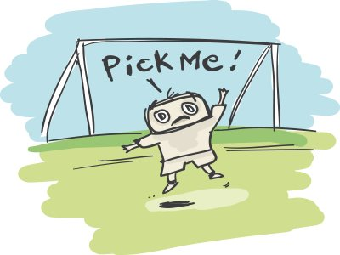
WHY DO I NEED A COVER LETTER?
Highlights your key accomplishments and skills
Adds focus to a Resume
Few employers consider a Resume without a Cover Letter
Cover Letter needs to be tailored to the job posting and each employer
Gives you as the individual the chance to sell yourself to the employer.
Notes:
GO THROUGH BULLET POINTS. EMPHASIZE CHANCE TO SELL YOURSELF

Slide 12
IMPORTANCE OF A COVER LETTER
A Resume is of limited value to an employer if they don’t know what kind of work you want
A Cover Letter tells the employer the type of position you are after and exactly how you are qualified for the position
Notes:
TELLS THE EMPLOYER WHAT KIND OF WORK YOU ARE AFTER AND WHAT QUALIFICATIONS YOU HAVE TO CARRY OUT THAT ROLE

Slide 13
COVER LETTERS
A FEW POINTS TO CONSIDER
What type of Cover Letter are you going to write
Address Red Flags – Employment gaps, frequent job changes, lack of direct experience and possible career shift
Notes:
1. THERE ARE A NUMBER OF DIFFERENT COVER LETTERS TO CHOOSE FROM. PICK WHAT BEST SUITS THE ROLE YOU ARE AFTER. 2. BE PREPARED TO ADDRESS EMPLOYMENT GAPS ETC

Slide 14

SO WHY DO I NEED A RESUME AND COVER LETTER?
Notes:
THESE ARE 2 KEYS ELEMENTS FOR GETTING EMPLOYMENT. THE BETTER THEY ARE, THE MORE CHANCE YOU HAVE OF GETTING BACK INTO THE LAND OF THE EMPLOYED AND HOPEFULLY IF WE CAN PRODUCE GOOD RESUMES AND COVER LETTERS, WE CAN ALL END UP HERE!!

Slide 15
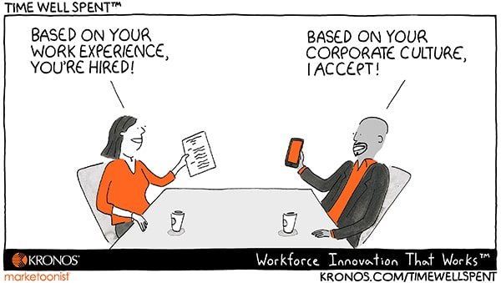
Notes:
AND HOPEFULLY IF WE CAN PRODUCE GOOD RESUMES AND COVER LETTERS, WE CAN ALL END UP HERE!!

Slide 16

Interview Skills

Slide 17
Before the interview
Research the company
Learn as much about the role you are applying for as you can
Use AI to rehearse answers to common interview questions
Notes:
Before your interview find out more about your target company by learning its history (when it was formed, what problem(s) it was made to solve, etc.), work culture, values, as well as ongoing and future initiatives.
Once you’ve done your research on the company, focus specifically on the position you’re being considered for.
For instance, if you already know what team you’d be joining, try finding out:
* what projects and goals they’ve been working on lately
* the work culture they’ve formed
* how you’d fit in as an active team member
Rehearsing your answers to common interview questions can boost your confidence and help you show up to an interview feeling well-prepared.
* hone in on exactly what experiences you want to share, and how you plan to express them
* stay calm and confident during the interview process
* show employers why you’re the best candidate for the job
* demonstrate your readiness and interest in the role

Slide 18
During the Interview
Deliver honest and positive answers
Pay attention to your body language
Discuss specific examples and results of your work
Take time to respond
Prepare a list of questions for the interviewer
Notes:
5. Providing honest and positive answers about your qualifications shows the interviewer you’re genuine and a good fit for the role.
Being honest doesn’t mean you need to point out all the ways your experience doesn’t align with the role. You should frame your experience positively by speaking about your skills and accomplishments and how they translate to the job.
6. Interviewers also pay attention to your body language (whether they realize it or not), so show them you’re excited to be there and capable of doing a great job as their potential employee. Make sure to pay extra attention to your body language if you’re doing a video interview, as it’s easy to get too comfortable when conducting the interview from your own home.
7. In addition to the questions that interviewers might ask, come prepared with specific examples demonstrating your strengths, skills, and experience.
Here you want to keep in mind key achievements that you have so that when the right question comes up you can insert them into your answer naturally.
Also use the STAR method for answering. STAR stands for Situation; Task; Action; Result. For example “Tell me about a time when you had a disagreement with a colleague.
8. When you’re answering questions on the spot, you don’t always have an answer at the ready. And that’s okay. It’s better to take a moment to think about your answer than start to ramble without a clear idea of what it is you’re trying to say.
A simple “Do you mind if I take a moment to think of a good example?” isn’t going to have a negative impact.
It's a good idea to ask for clarification when you are not quite sure what a question meant. This shows interviewer that you’re not afraid to admit when you don’t fully understand something or need further direction and second you give the interviewer exactly what they are looking for.
9.. In addition to the questions that interviewers might ask, come prepared with specific examples demonstrating your strengths, skills, and experience.

Slide 19
After the interview
Follow up at the appropriate time
Notes:
After the interview follow up with the interviewer with a thank you email or letter within 24 hours after the interview.
A thank you email also allows you to clarify any details that may have been unclear during the interview process, and to restate any key skills or experience you think would make you a good fit for the position.

Slide 20
The Power of Positivity & Building your Confidence

Slide 21

Positive Beliefs and Attitudes
Beliefs are the opinions or point of view that we cultivate over time because of what we learn and experience.
beliefs affect the way we act
beliefs can support you in achieving your goals
Attitudes are the ways we respond to situations or people. We create attitudes from what we learn and experience.
attitudes affect the way we think, act and feel.
Positive ones can make the difference between success and failure.
can either hold you back or put you ahead. If you have a positive belief and attitude, you will make the most out of change
It’s up to you

Slide 22

in communication, stress management, change resilience and career self-reliance. Will help you adapt to changes, build positive relationships and improve quality of life.
Positive skills
Communication skills will help you build more positive relationships at home and at work
Positive communication:
Is open, honest, direct
Shows that you respect the other person
Values the thoughts, ideas and feelings of the other person
Is a win for everyone
Stress Management Too much work, pressure and responsibility can create stress, even for people who are hard works and energetic
A certain amount of stress is normal and can be a good thing
It’s a motivator, however, can take away energy and leave you less able to succeed
The good news, you can make changes that will help you avoid it and learn how to better deal with the stress you can’t avoid
Positivity is like a muscle: Keep exercising it, And it becomes a habit - Natalie Massenet
Notes:
Examples:

Slide 23
Positive skills
Change Resilience is how quickly you can recover from something that wasn’t planned or expected.
The skill of change resilience is something that can be learned.
Change resilience is a skill that involves:
Allowing yourself time to get used to the change
Seeing the good things the change presents
Making change a part of your life
Career Self-Reliance when you have career self-reliance, you put yourself in charge of your own career.
It helps you achieve success and personal satisfaction
It means being clear about what you want in life, whether you’re working or not
When you’re career self-reliant you:
Have a take charge approach
Take responsibility for your career
Plan and mange your own learning
You career self-reliance growth can mean
Changing employers
changing the type of work
Choosing self-employment

Slide 24

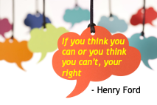


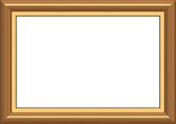



Building your Confidence
elevates your performance in all aspects of your life.
Think positively whenever possible: Everyday we think about situations and make decisions based off our thoughts.
Use positive affirmations daily: repeated affirmations bolster our personal power, making us less susceptible to threats
Write a self-confidence letter to yourself: The intention is to reaffirm how special you are, that you are loved and can achieve great things. This is only for you!
Reframe your discouraging thoughts.
Use SMART goals: specific, measurable, achievable, relevant, time-based tasks.
Take bite-sized chunks: To avoid felling overwhelmed tackle things in smaller more reasonable pieces.
Celebrate success: Moments spent celebrating successes mentally and emotionally sets us up for more wins

Slide 25

Technology

Slide 26


Technology is an essential tool in today’s techy revolution for Career Building
Technology is the backbone of modern careers
Digital skills is equivalent to new literacy skills
Adaptability and life-long learning are essential

Slide 27





…The moment your day begins technology is already at work, organizing, connecting,& preparing you…
CHECKING YOUR SOCIAL MEDIA PLATFORMS, LINKEDIN, FACEBOOK, THE WEATHER APP
CHECKING YOUR DIGITAL SCHEDULE FOR APPOINTMENTS, CONNECTING WITH YOUR CHILD’S TEACHER
…AND MAGICALL, NETWORKING BECOMES YOUR BEST FRIEND, IT’S JUST THAT EASY!

Slide 28


…and here we are – the workplace, where the real world of technology begins…
And now the real world of technology begins, spreadsheets, data entry, programing, coding, AI platforms…
Mastering these skills turns everyday technology into powerful tools & knowledge that will propel you beyond your own mind

Slide 29


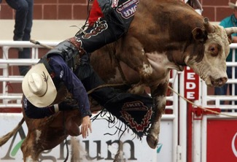
…But not to worry MCG Careers is here to bridge the gap in learning, resources, compiling & understanding the new techy way! And its going to be a wild ride!
This Photo by Unknown Author is licensed under CC BY-NC
YAHOO!

Slide 30

The End

